Slide 1
Emerging Sequencing Technologies

Slide 2
Learning Objectives
To familiarize yourself with newer sequencing technologies
To learn about other applications for sequencing technologies beyond the genome

Slide 3
Third Generation Sequencing
Currently in transition / development
Hard to define what “3rd” generation means
Typical characteristics:
Long (10,000bp+) sequence reads
Single molecule (no amplification step)
Often associated with nanopore technology
But not necessarily!

Slide 4
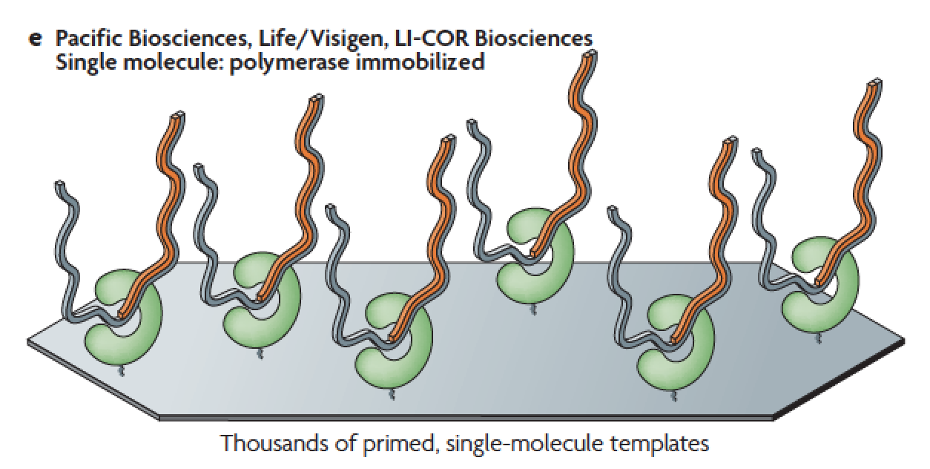
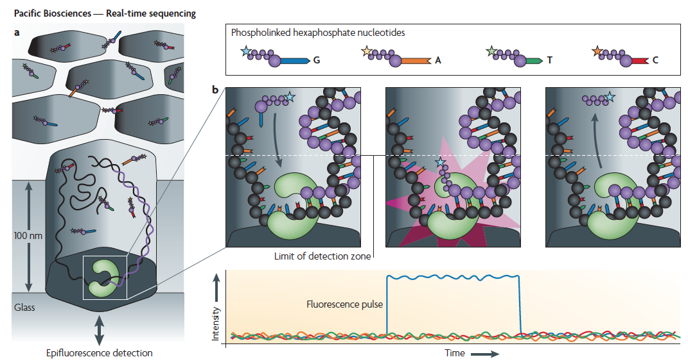
Pacific Biosystems – Real Time Sequencing
zero mode
waveguides
Metzker, ML (2010), Nat. Rev. Genet, 11, pp. 31-46

Slide 5
Pacific Biosystems Video
https://www.youtube.com/watch?v=v8p4ph2MAvI

Slide 6
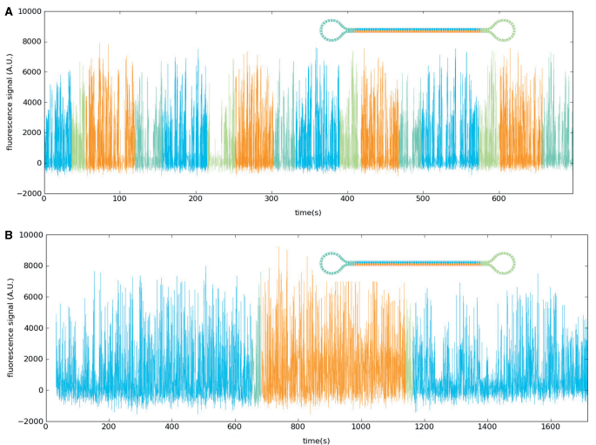
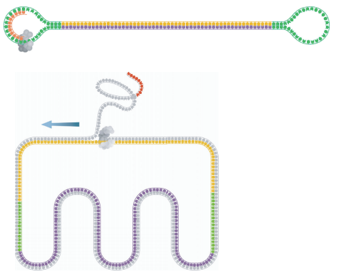
Pacific Biosystems – Circular Consensus
SMRTbell template
Subread Consensus Sequencing
Travers, KJ et al (2010), Nucl. Acids. Res., 38(15) pp. e159

Slide 7
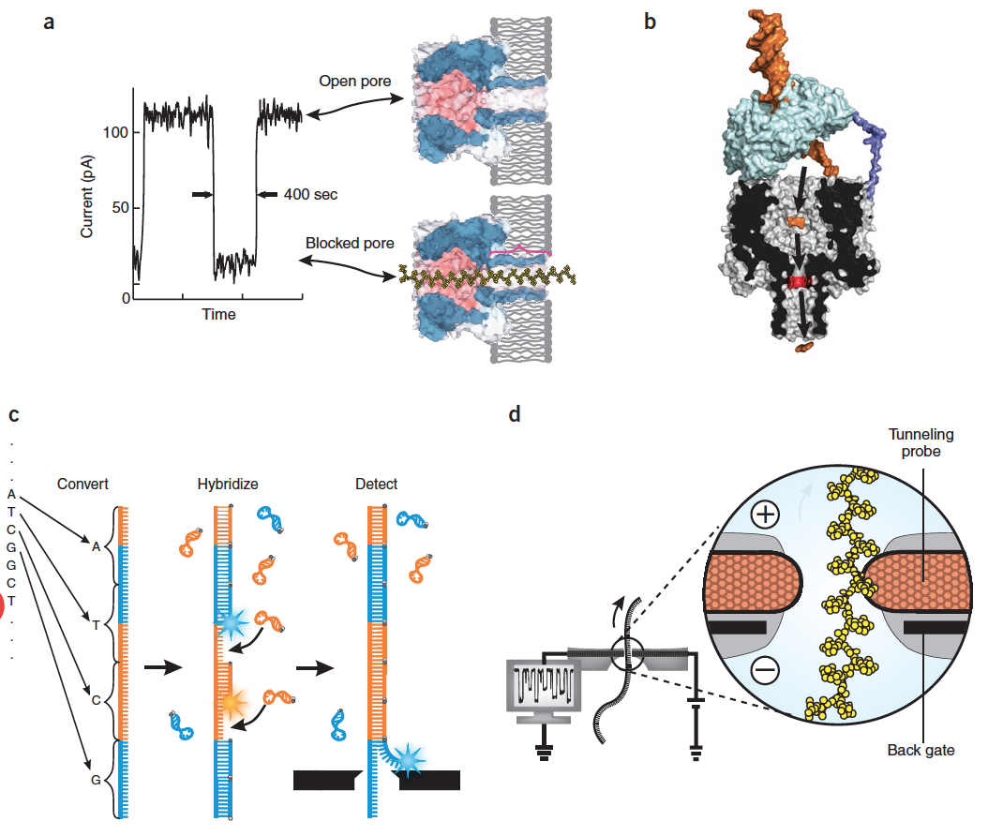
Strategies for Nanopore Sequencing
Strand-sequencing using ionic current blockage
Exonuclease-sequencing by modulation of the ionic current.
Nanopore sequencing using synthetic DNA and optical readout
Strand-sequencing using transverse electron currents.
Branton, D (2008), Nat. Biotech, 26(10), pp. 1146-1153

Slide 8
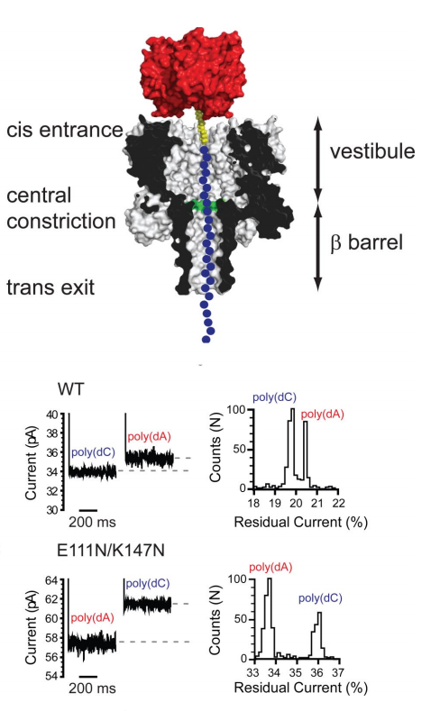
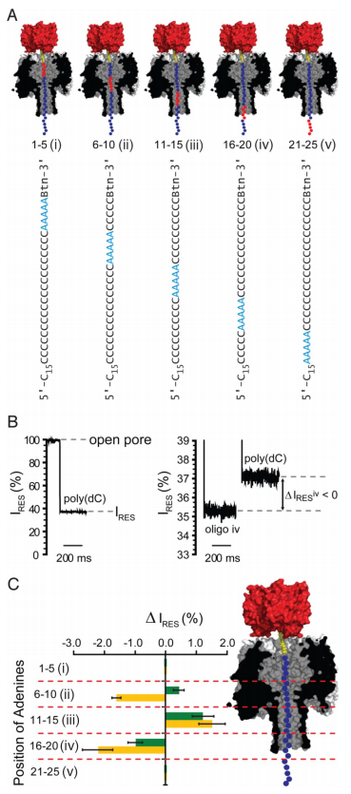
Discriminating Nucleotides via Nanopore
Stoddart, D (2009), Proc Natl Acad Sci, 106(19), pp. 7702-7707

Slide 9
Oxford Nanopore Sequencing
https://www.youtube.com/watch?v=E9-Rm5AoZGw

Slide 10
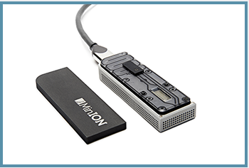
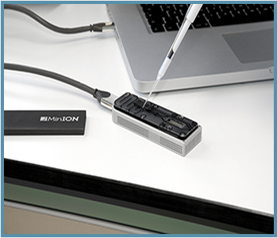
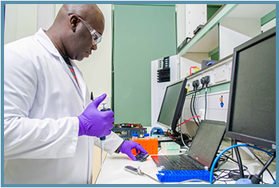
MinION – Miniaturized Sequencing
www.nanoporetech.com

Slide 11
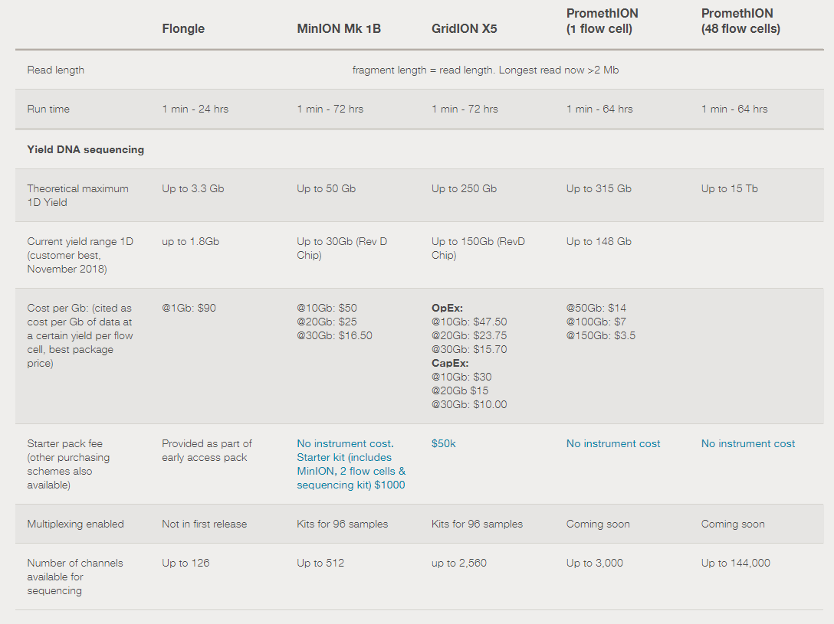
Comparison of Nanopore Platforms
https://nanoporetech.com/products/comparison

Slide 12
Beyond DNA Sequencing
Sequencing platforms provide for biological investigations beyond whole genome sequencing
The technology has been adapted and used for many other assays for molecular information, including but not limited to:
RNA structure and expression
Ribosome footprinting and translational dynamics
Transcription factor binding
Chromatin accessibility
These will be covered in more detail later in the course, but the next few slides will give a brief introduction

Slide 13
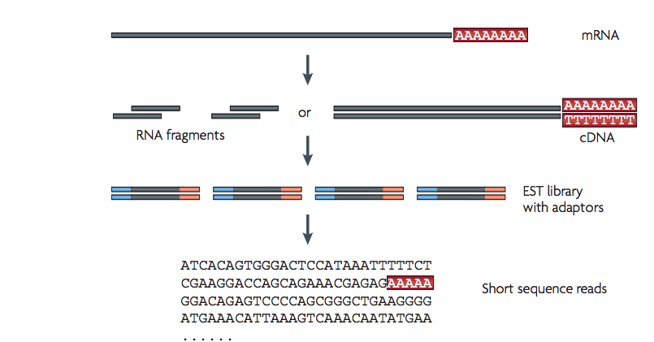
RNA Sequencing
Uses same technologies as DNA sequencing
Primary difference is in library preparation
RNA converted to cDNA through reverse transcription
Wang, Z et al (2009), Nat Rev Genet., 10, pp. 57-63

Slide 14
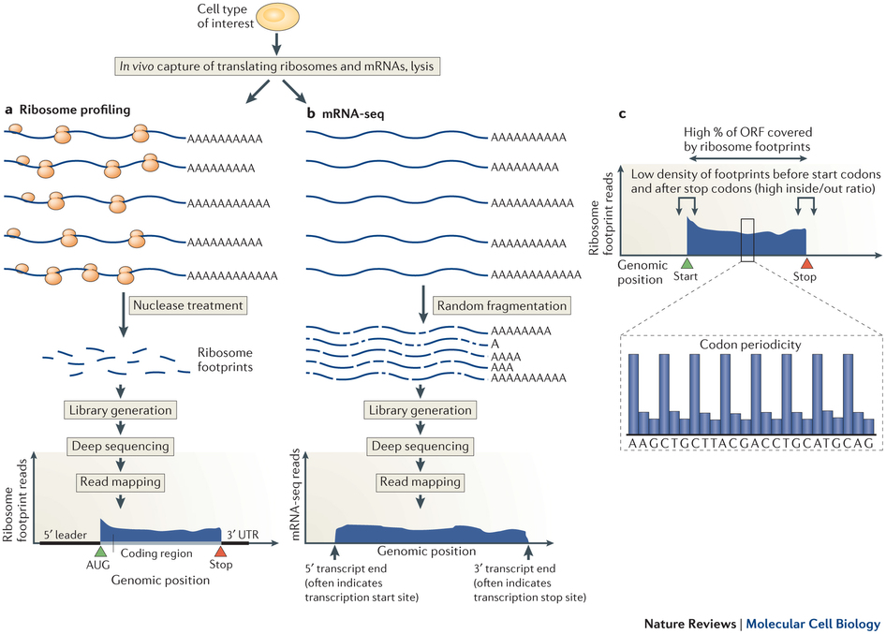
Ribosome Profiling (Ribo-Seq)
Brar and Weissman (2015), Nat Rev Mol Cel Biol., 16, pp. 651-64

Slide 15
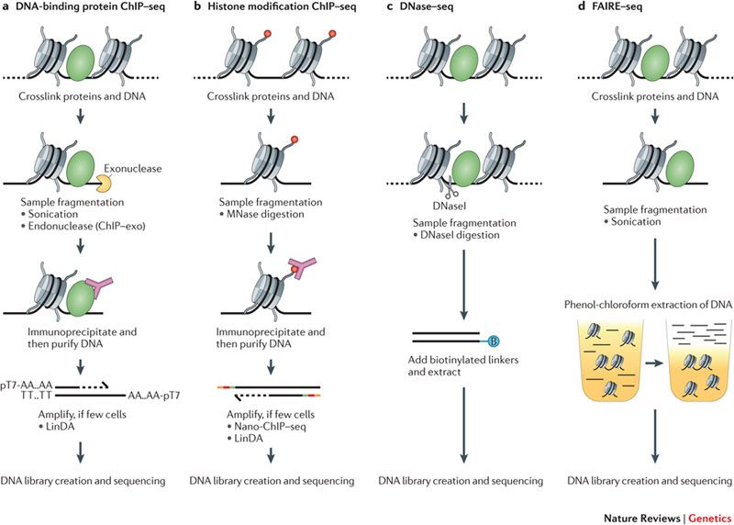
ChIP-seq (and beyond)
Furey, TS (2012), Nat Rev Genet., 13, pp. 840-852

